Slide 1




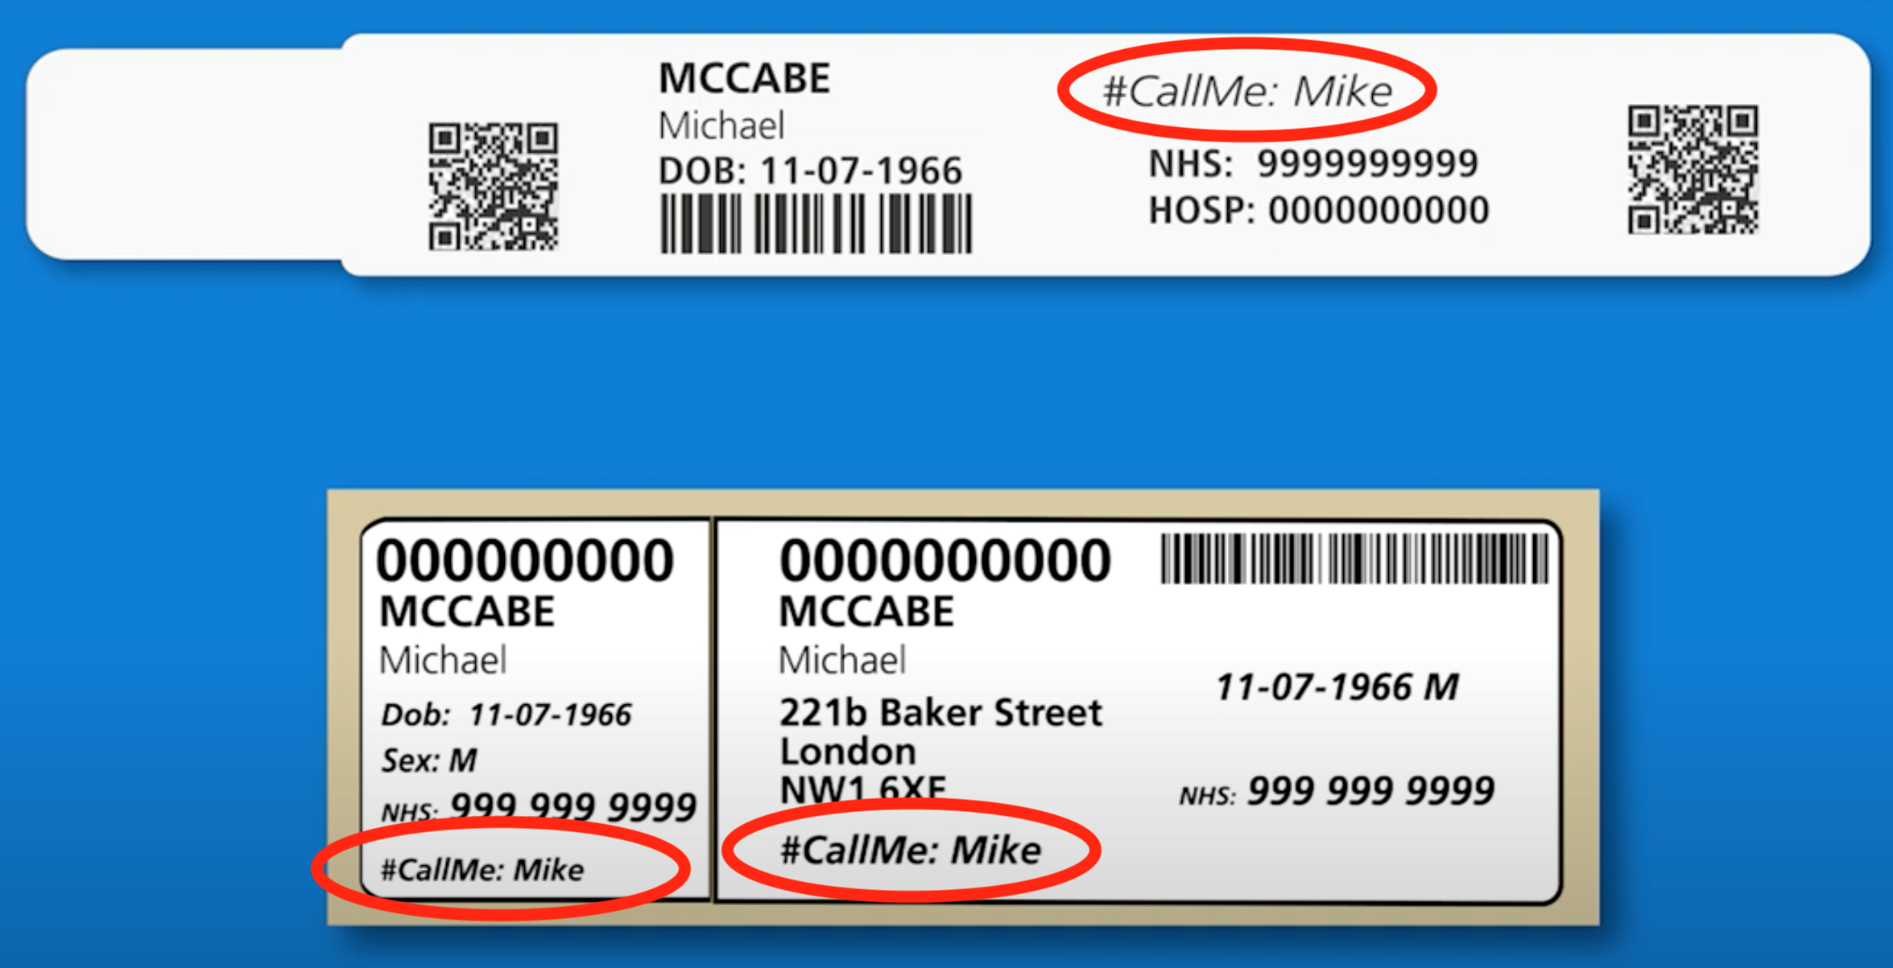
Dr Allan Clark
Dr Elizabeth Brodier
Dr Mike McCabe
INTRODUCTION
METHOD
An initial prospective observational study was conducted to determine how patients' preferred to be addressed by clinicians.
After direct questioning, a patient's preferred name of address was shared in the Trust's digital patient system in a GS1 manner, under a #CallMe prefix.
of what patients would like to be called on original inpatient stickers and name bands.
Patients may feel vulnerable when presenting for healthcare.
The default is for them to be addressed by their legal name.
However many patients choose to go by an alternate name.
Promotional image
RESULTS
Example of Patient identity wristband
Example of Patient identity label
More than 130,000 patients surveyed.
Over 30% of patients preferred to be addressed by a name different to their legal name.
Name preference differed by age and ethnicity.
CONCLUSION
#CallMe was fully integrated and rolled out across the trust.
Provides personalised care - simple and kind.
Ensures patients are addressed by preferred names.
Improves patient safety, trust & rapport.
Is understood and used by all healthcare professionals.
Do not match
Match

